Slide 1
IN PROJECTS

Slide 2
HotelS

Slide 3
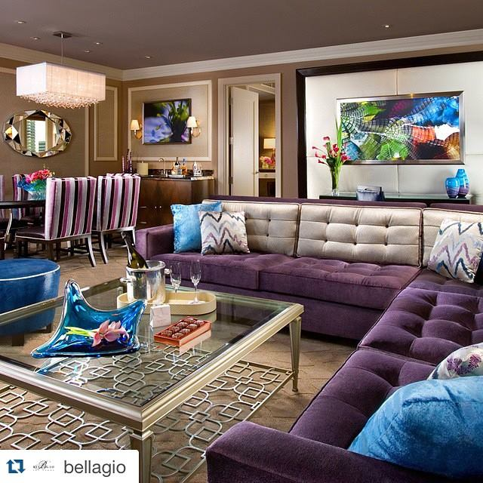
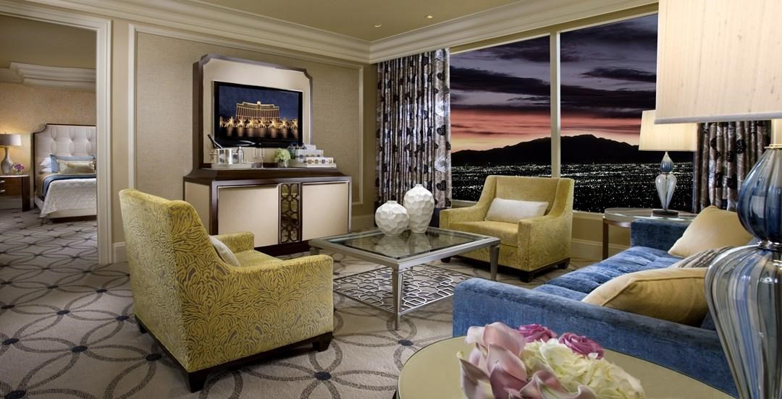
Bellagio Hotel & Casino Las Vegas, USA

Slide 4
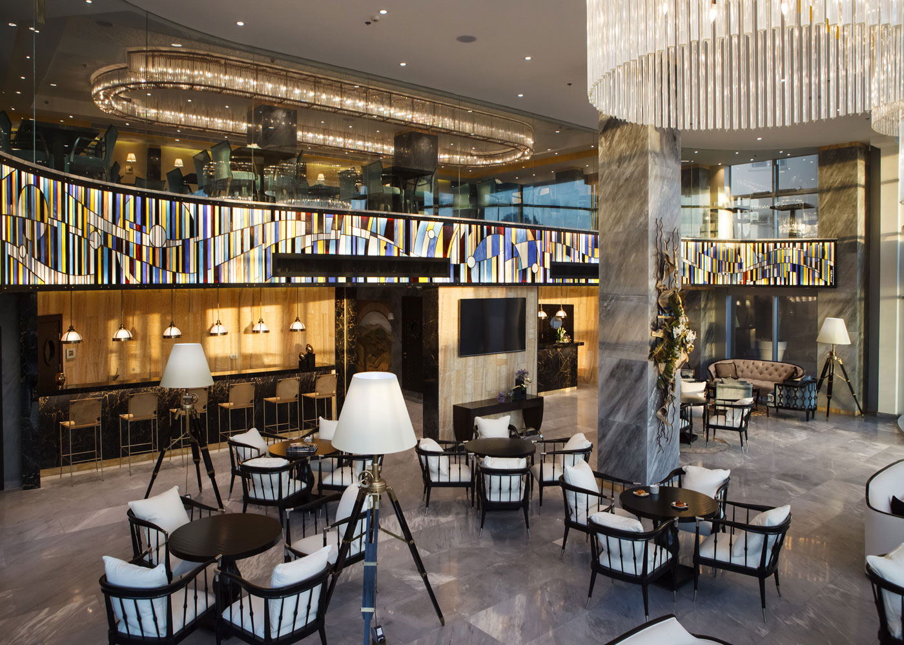
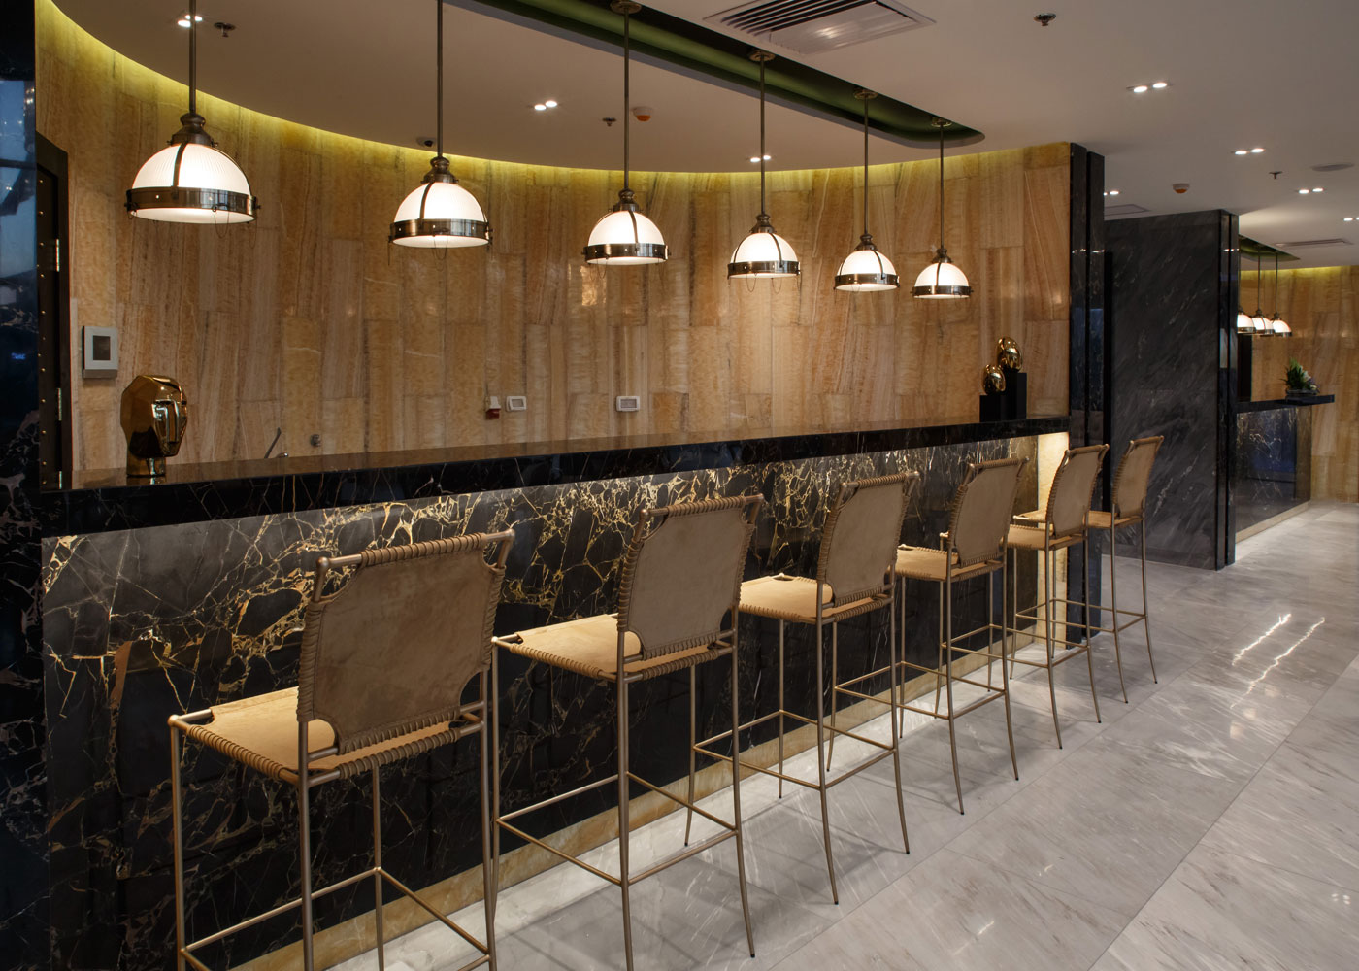
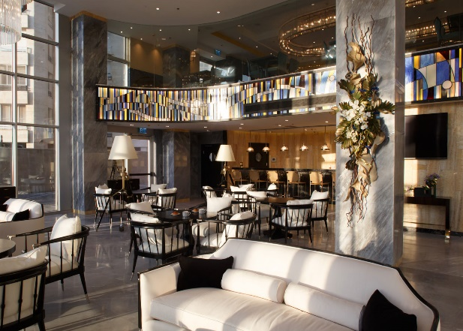
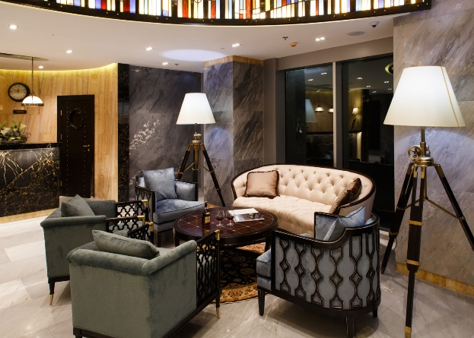
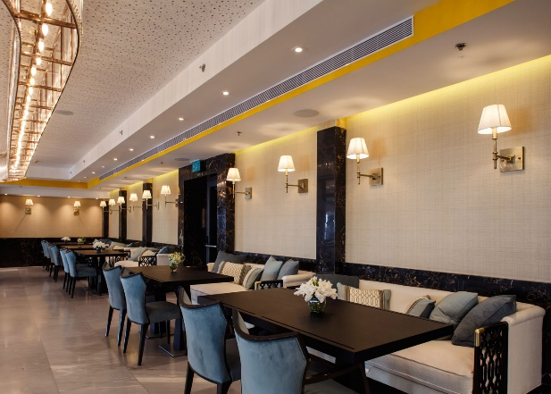
Medi Terre Hotel Netanya, Israel

Slide 5
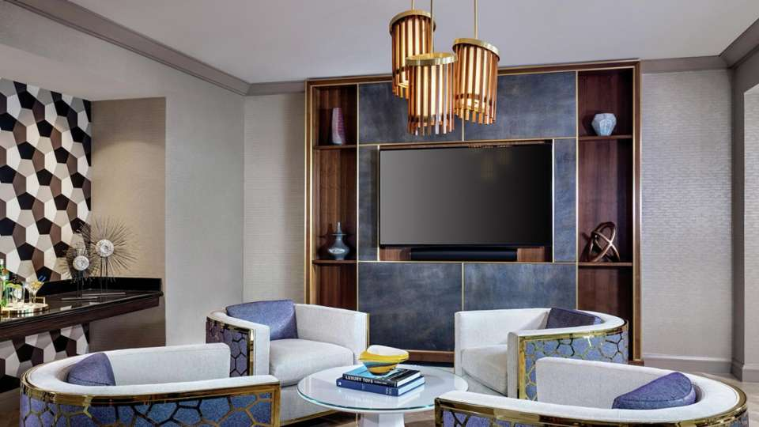
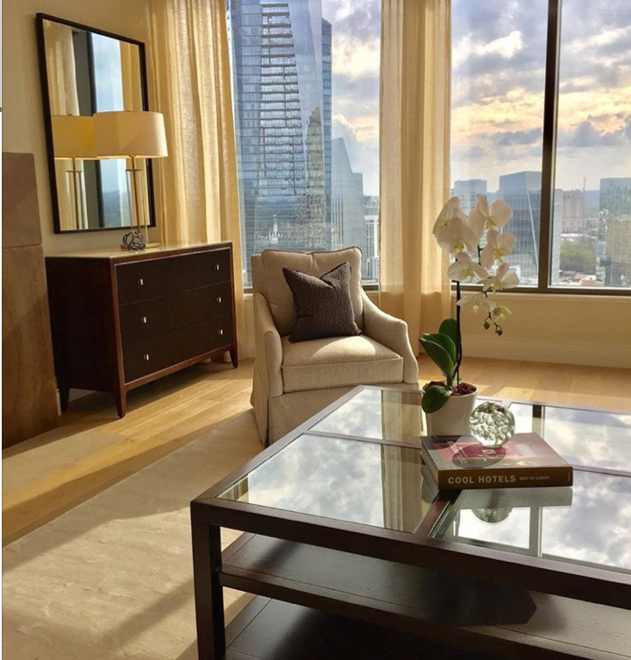
Mandarin Oriental Hotel Atlanta, USA
Mandalay Bay Hotel Las Vegas, USA

Slide 6
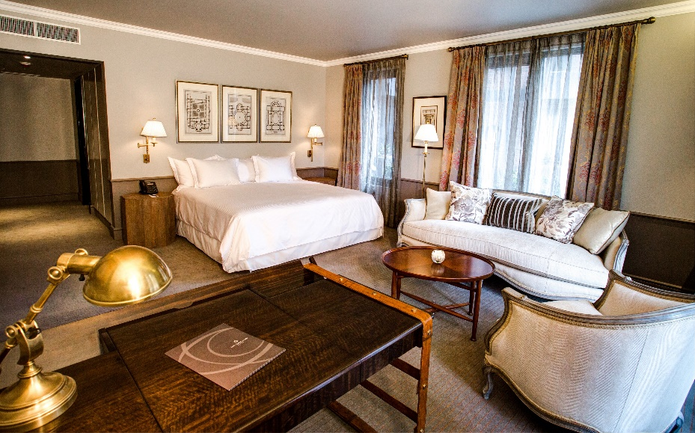
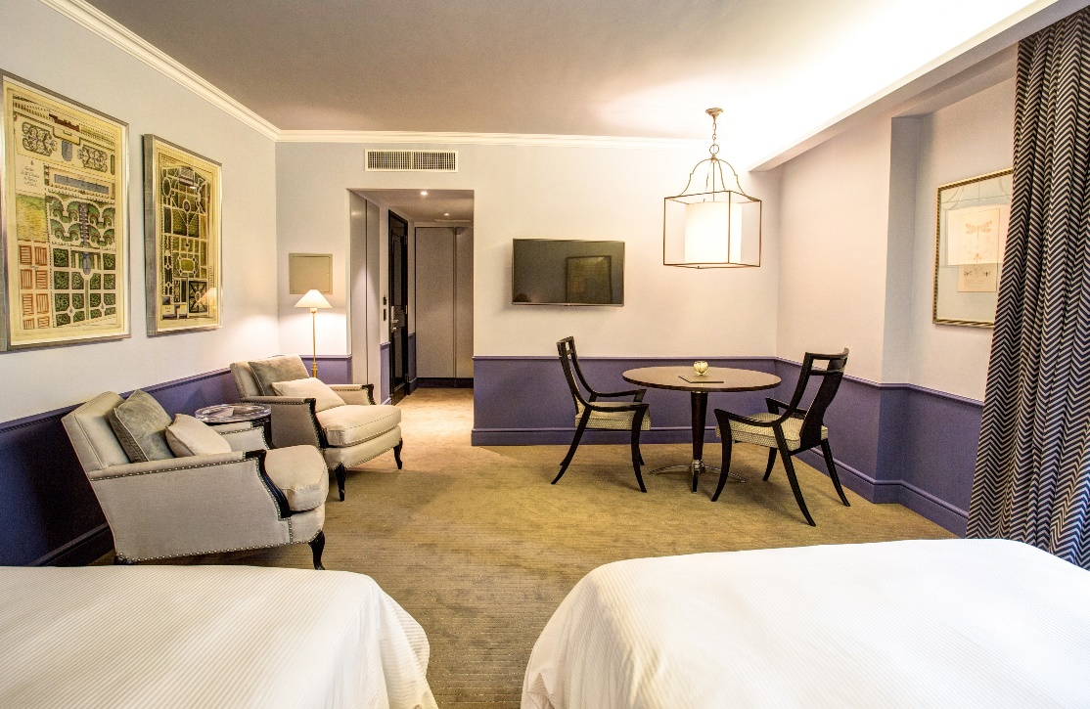
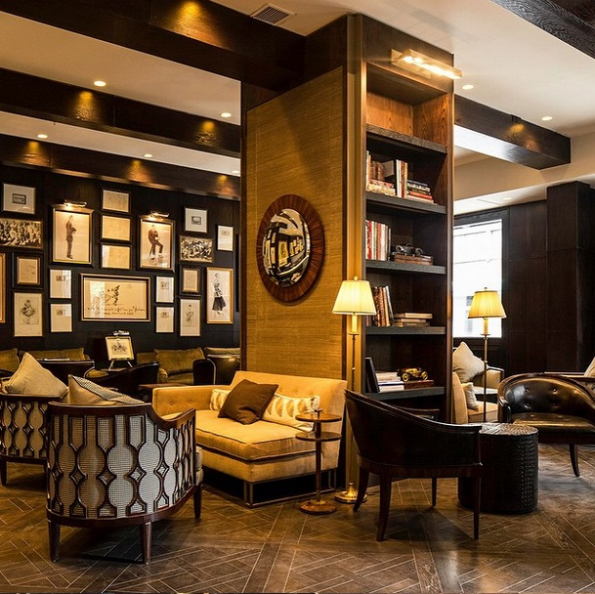
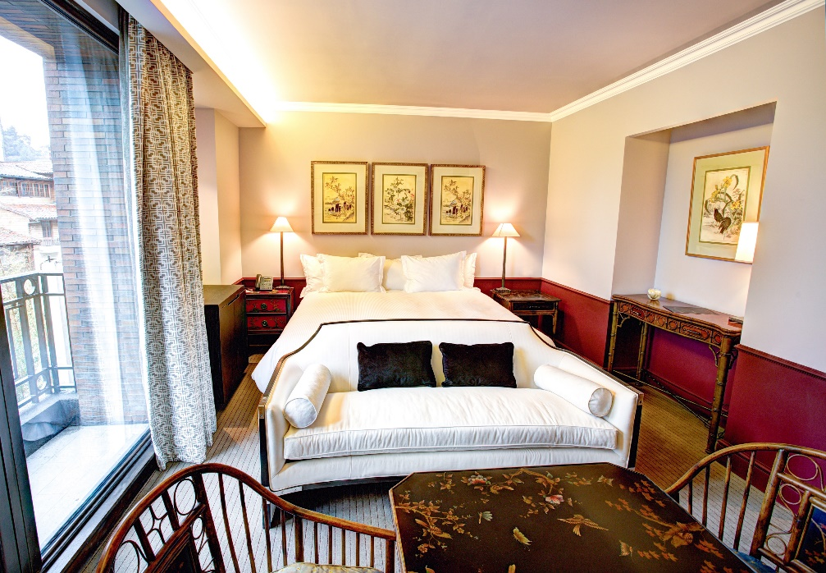
The Singular Santiago Hotel Santiago, Chile

Slide 7
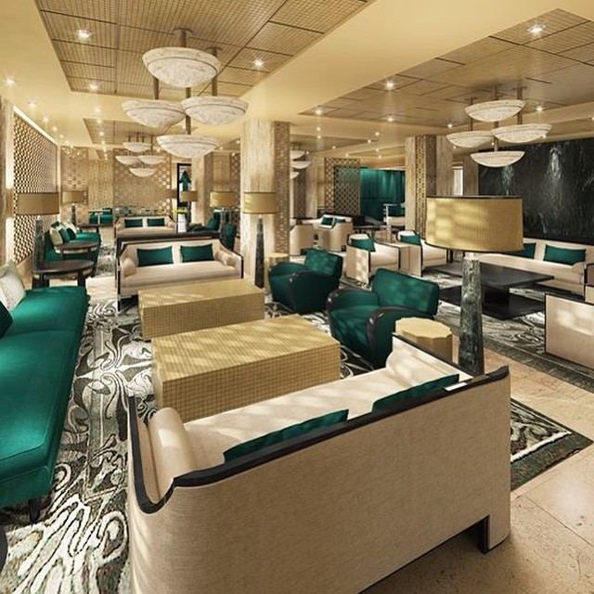
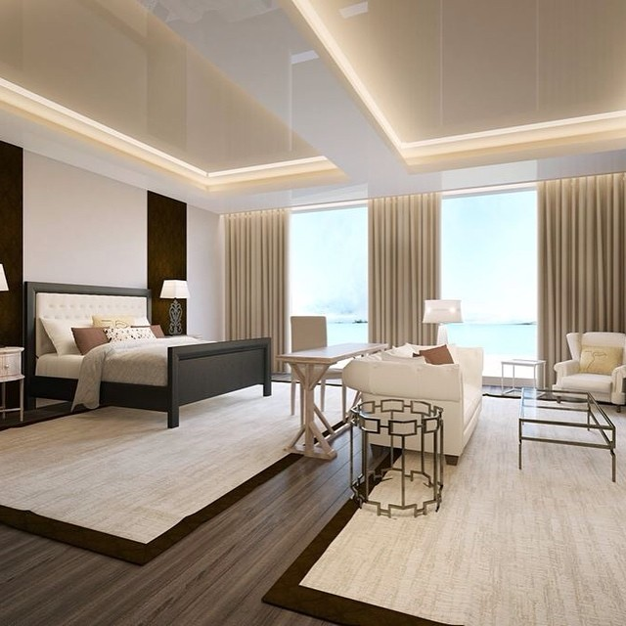
Hotel Proposal Greece

Slide 8
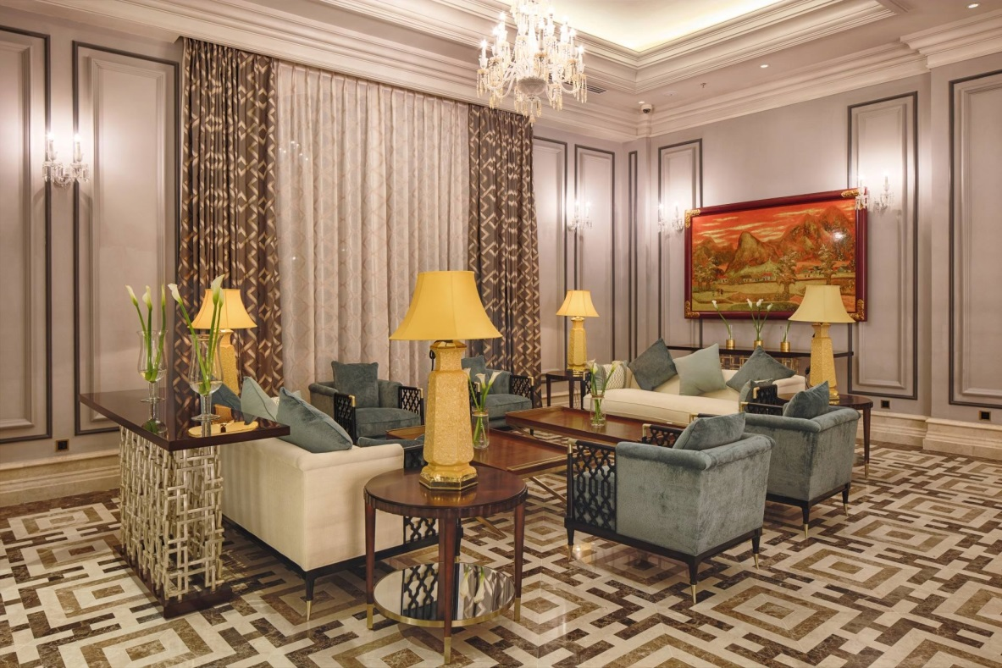
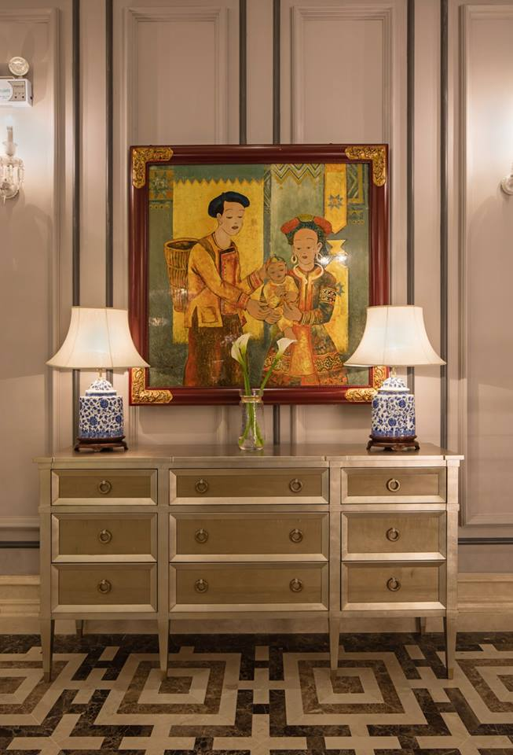
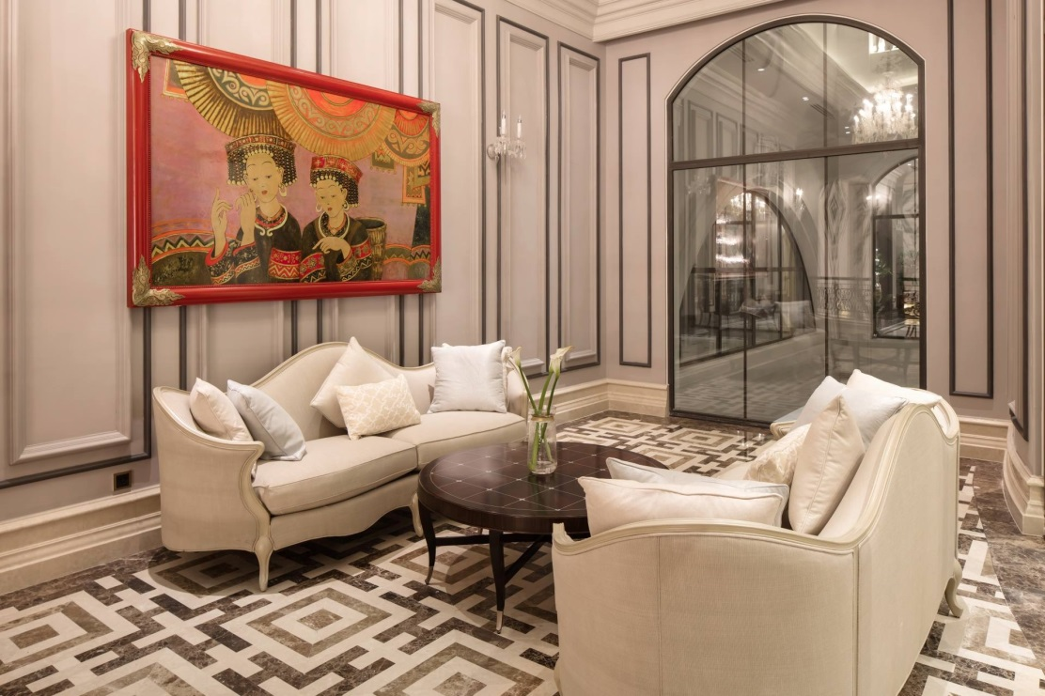
Silk Path Grand Resort
& Spa Sapa Hotel
Sapa, Vietnam

Slide 9
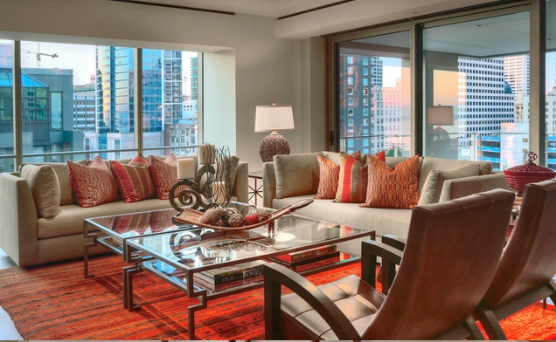
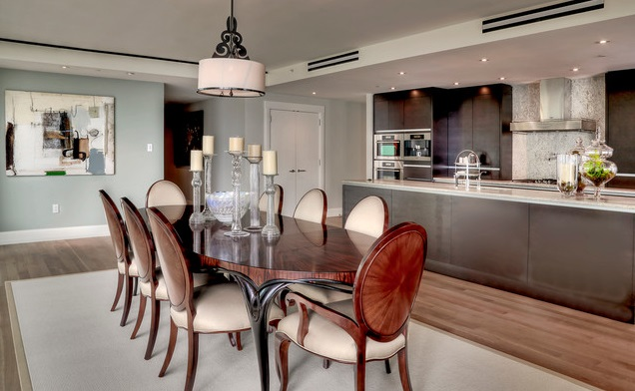
Four Seasons
Seattle, USA

Slide 10
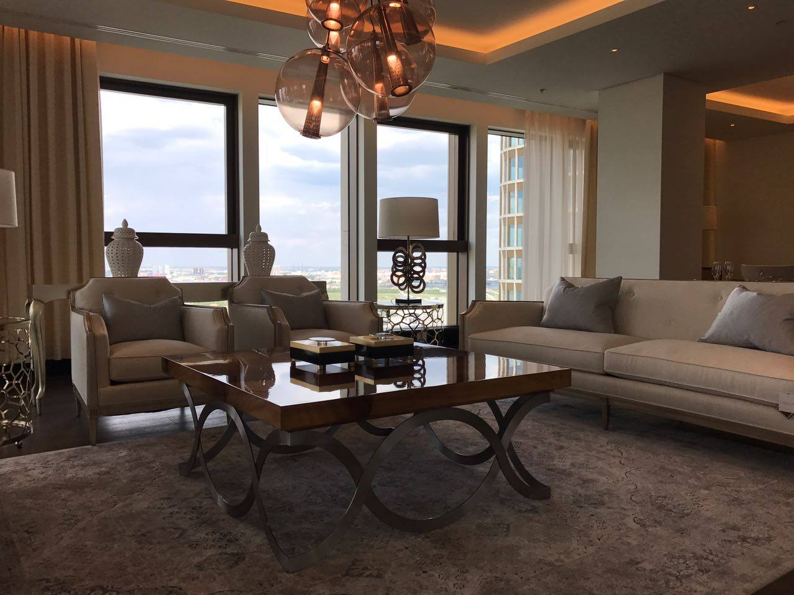
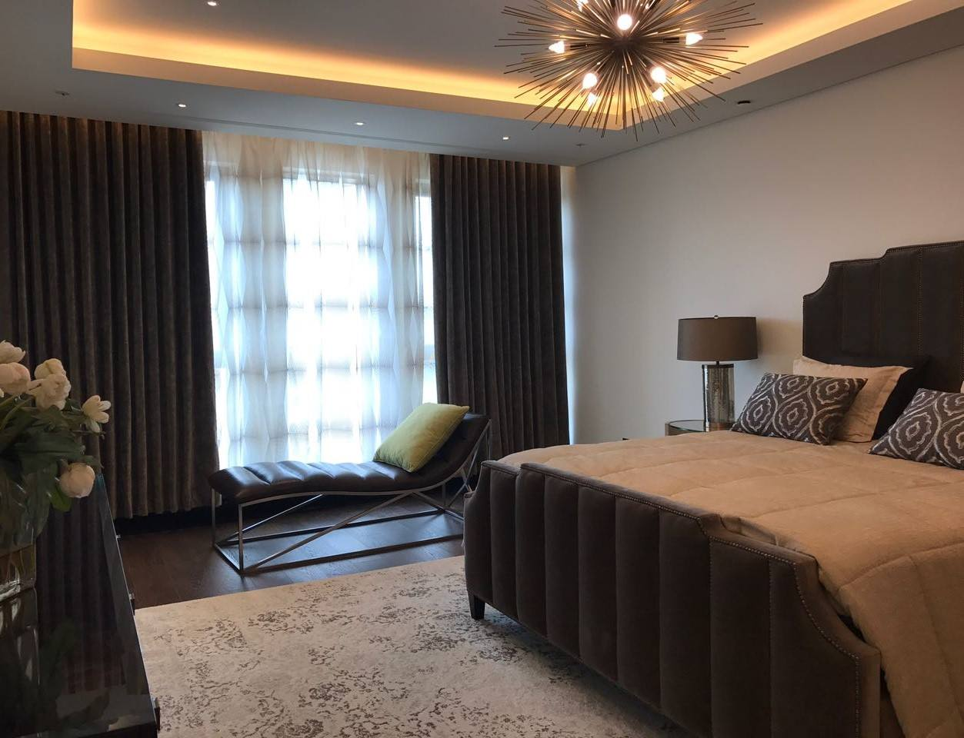
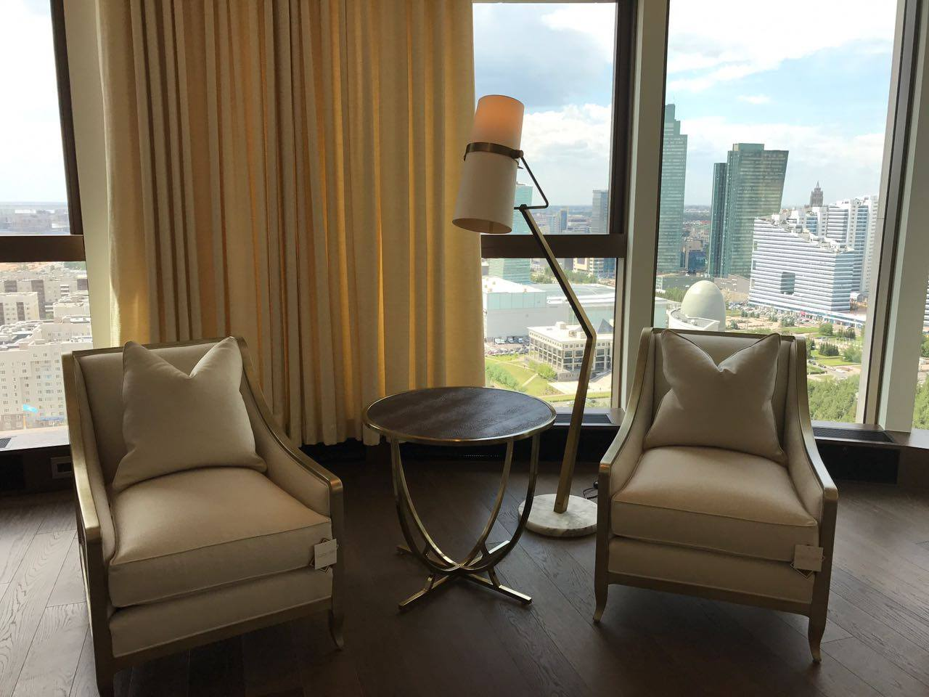
The Ritz-Carlton Astana, Kazakhstan

Slide 11
Residential

Slide 12
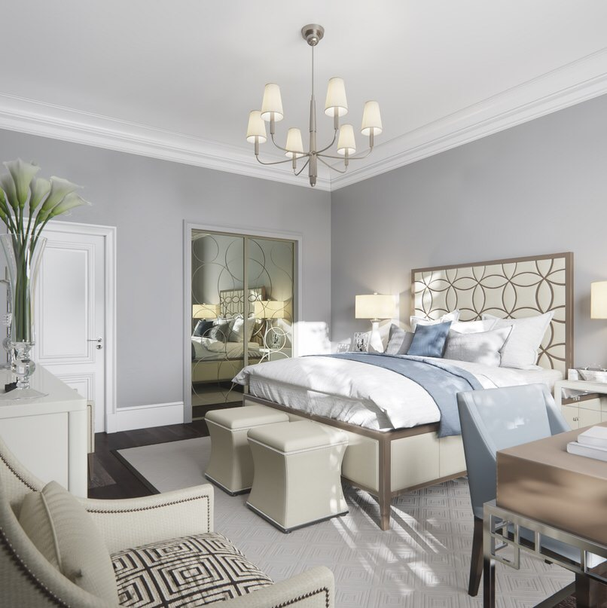
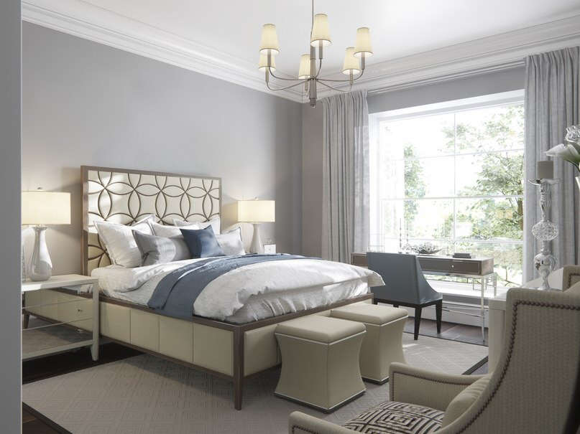
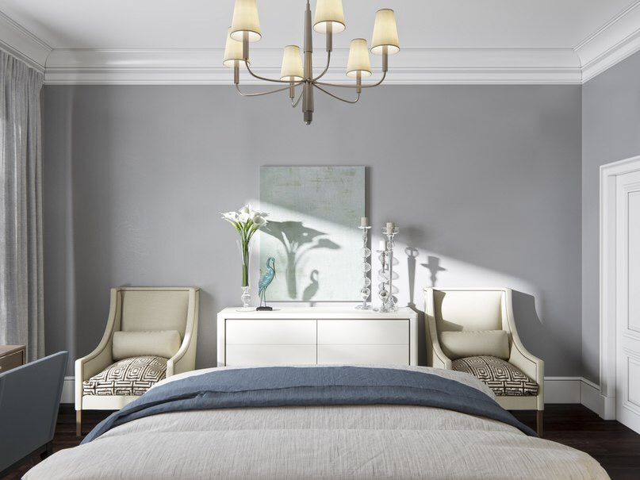
Alexander Akimenkov Studio
Saint-Petersburg, Russia

Slide 13
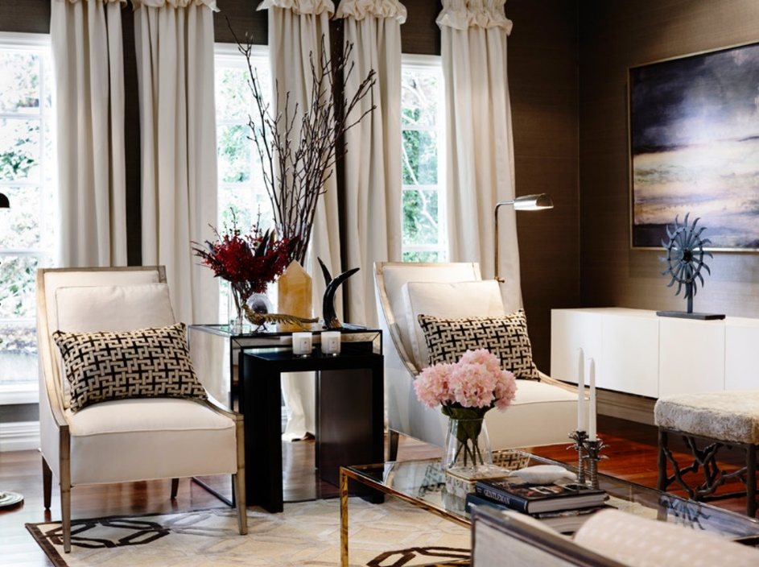
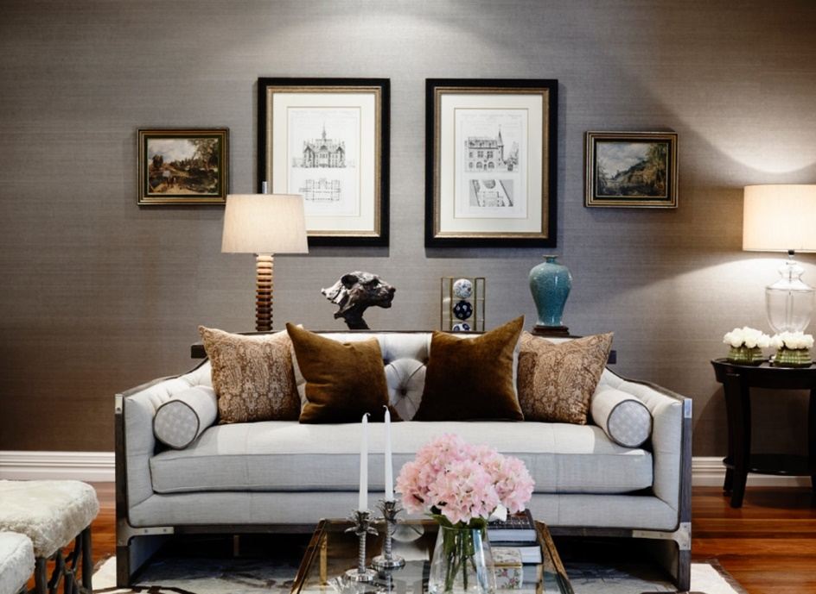
Alexander Pollock Melbourne, Australia

Slide 14
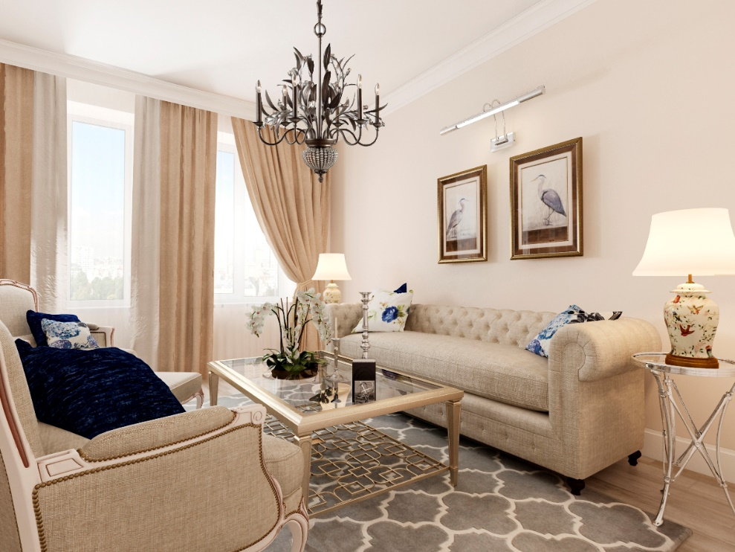
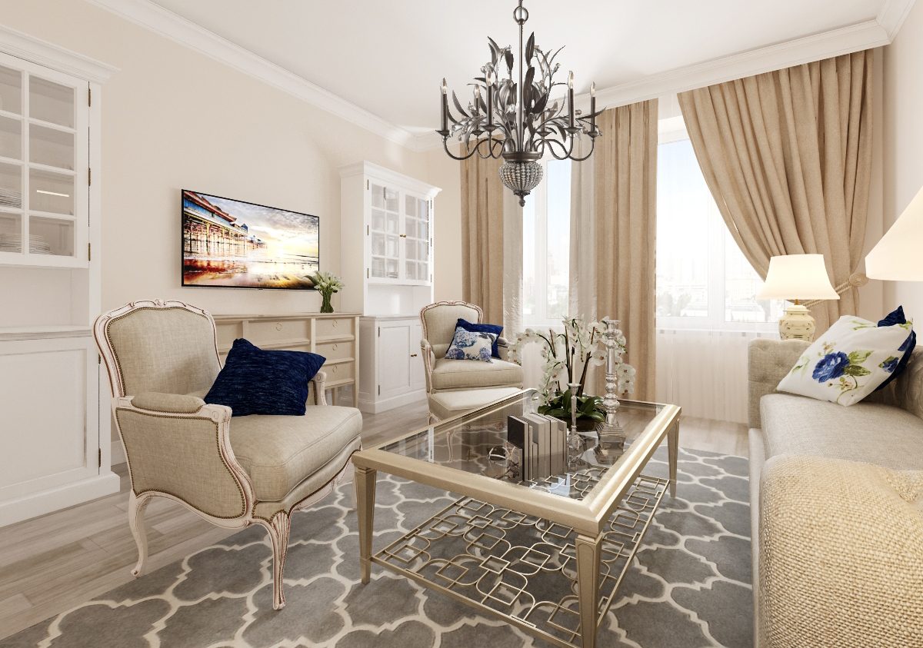
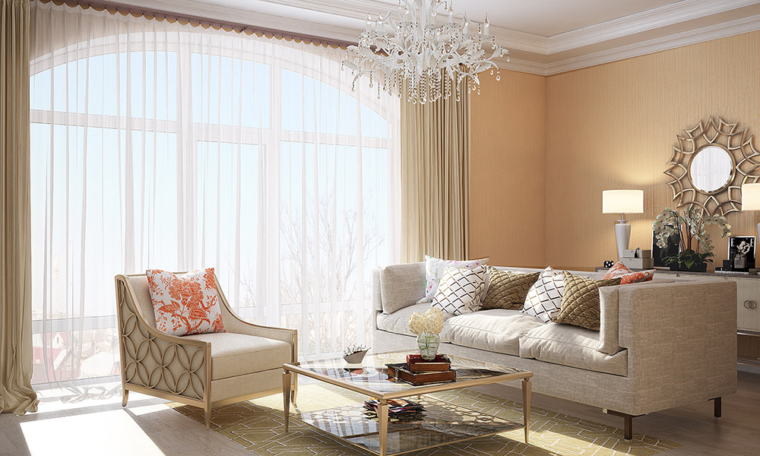
Alla Bagrova
Russia

Slide 15
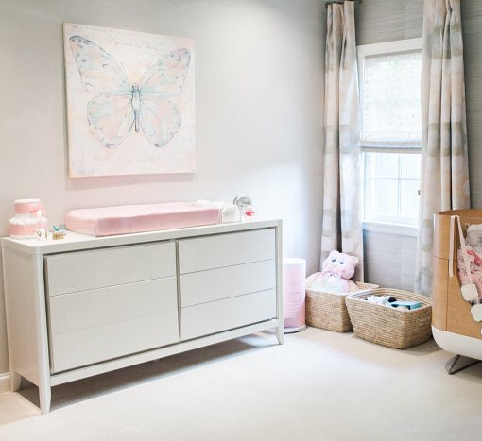
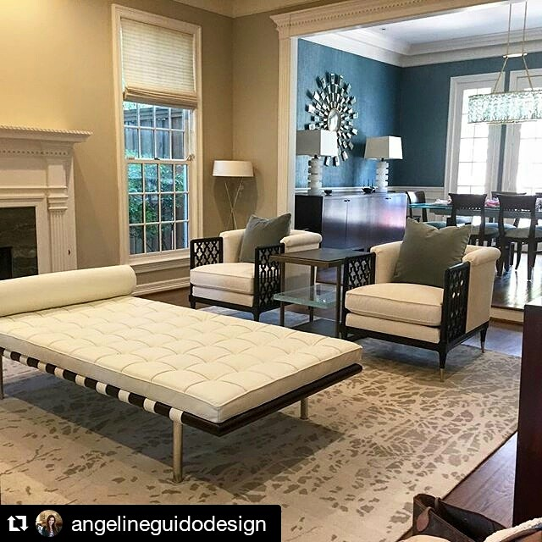
Angeline Guido Design
Dallas, USA

Slide 16
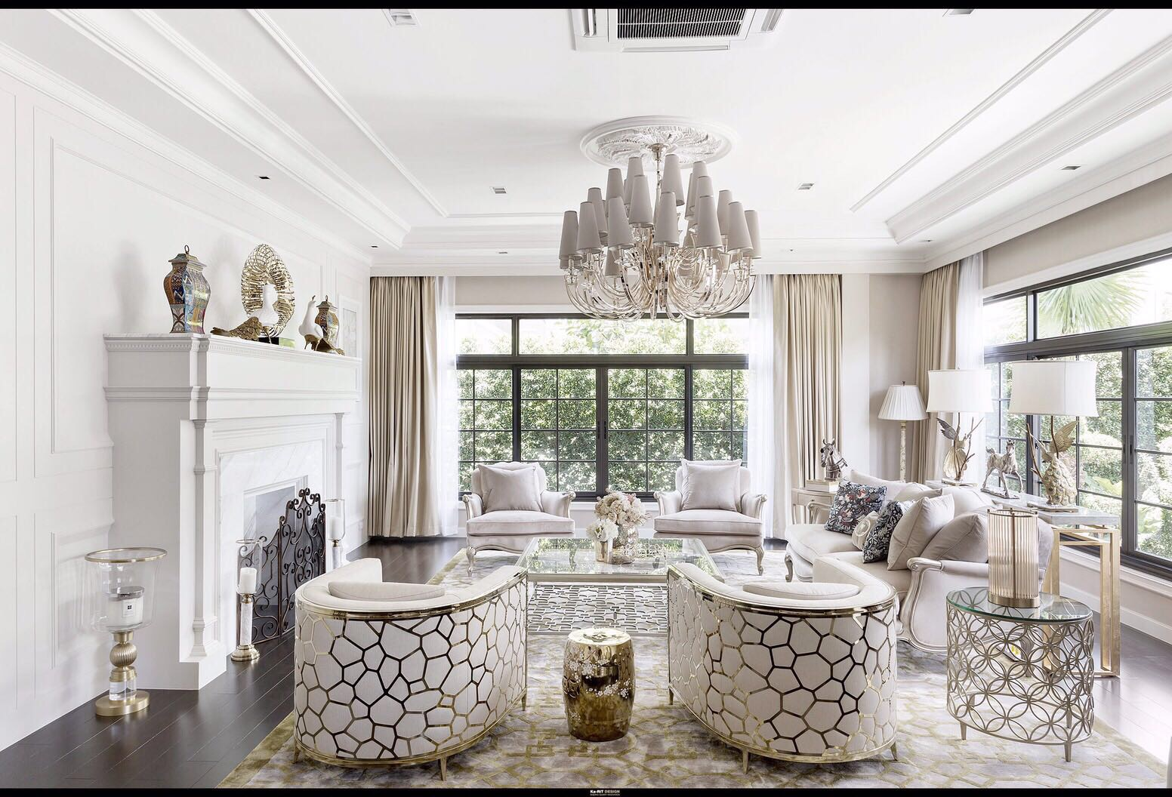
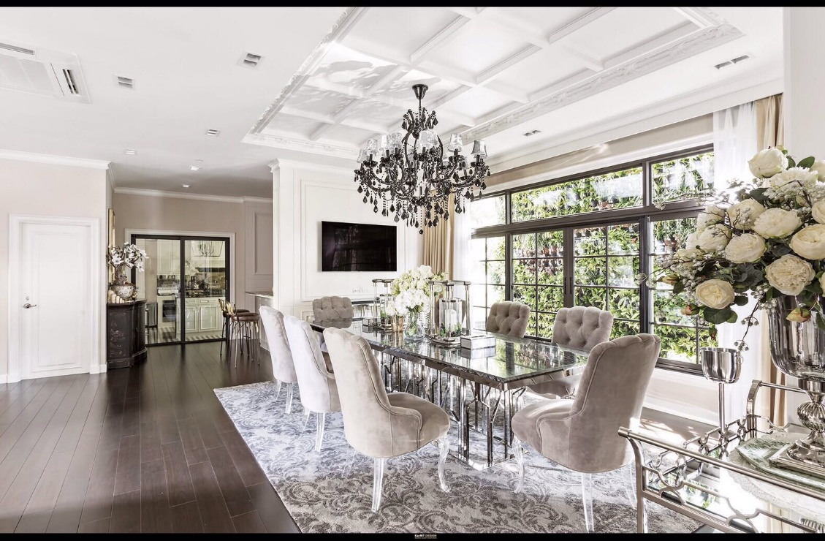
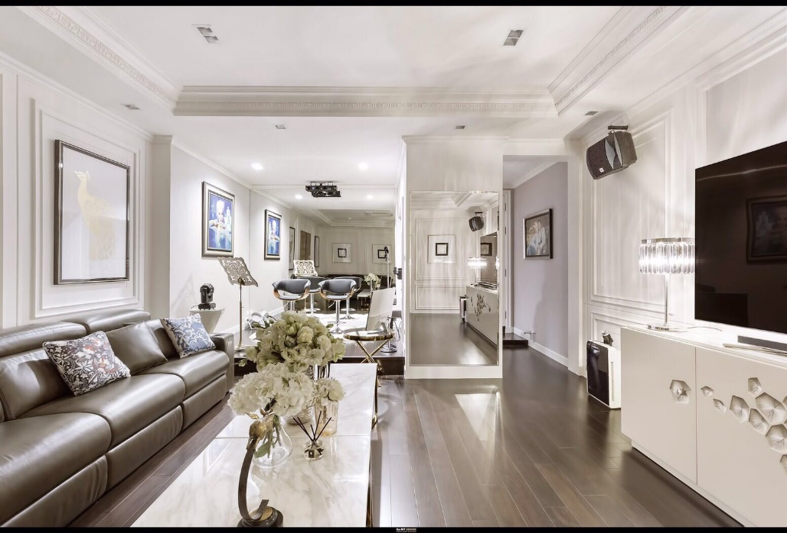
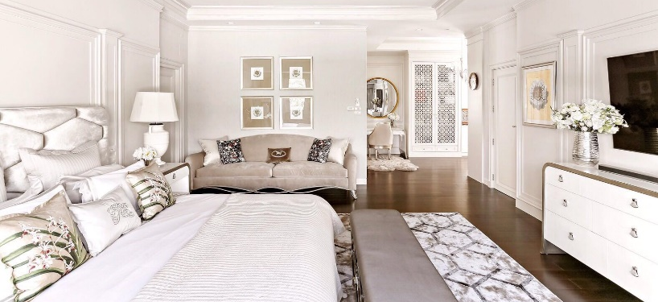
Residence
Bangkok, Thailand

Slide 17
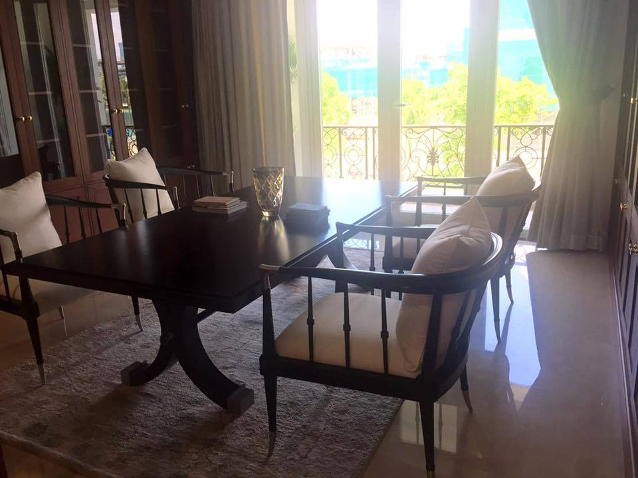
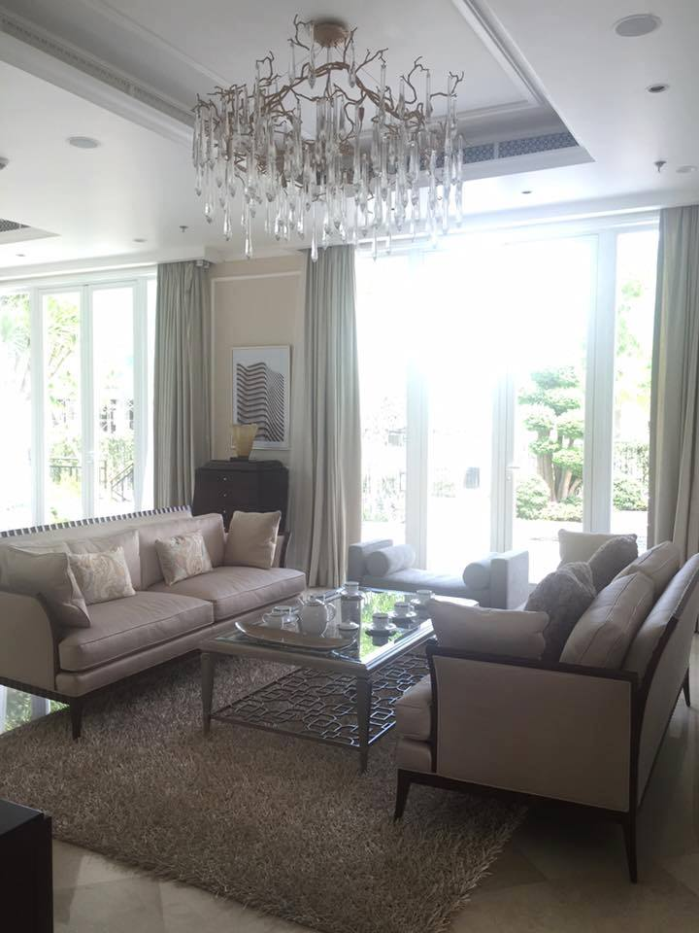
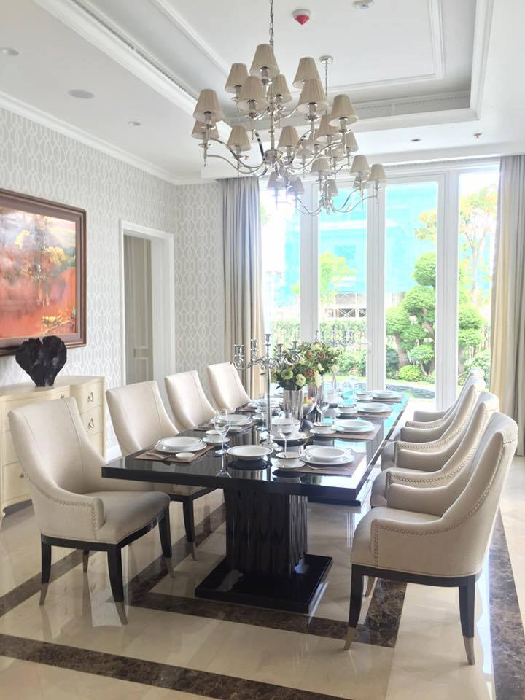
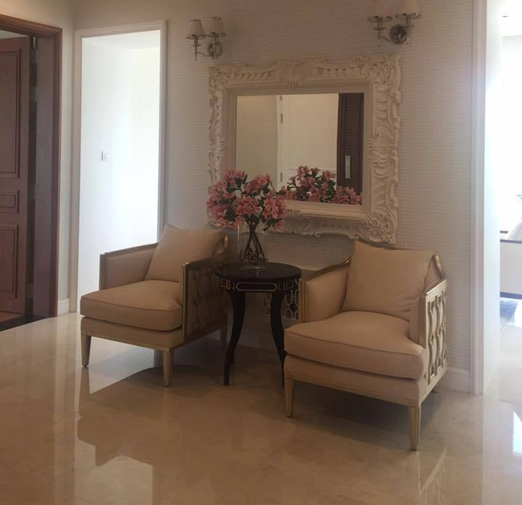
RESIDENCIAL Villa Vietnam

Slide 18
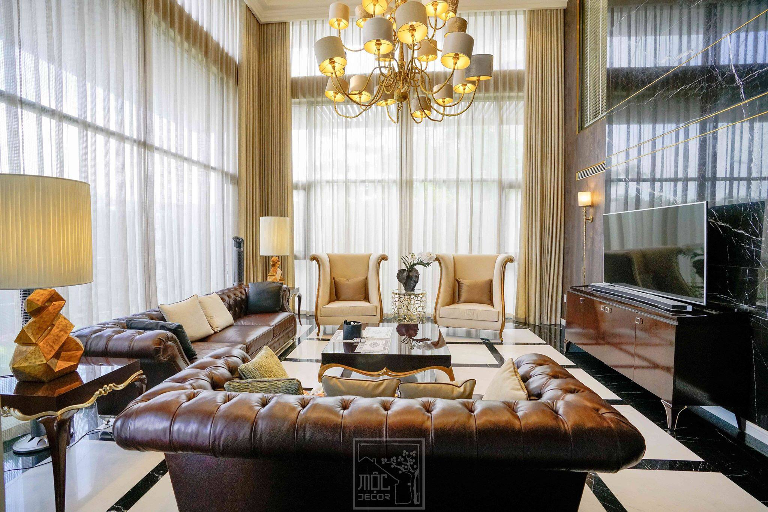
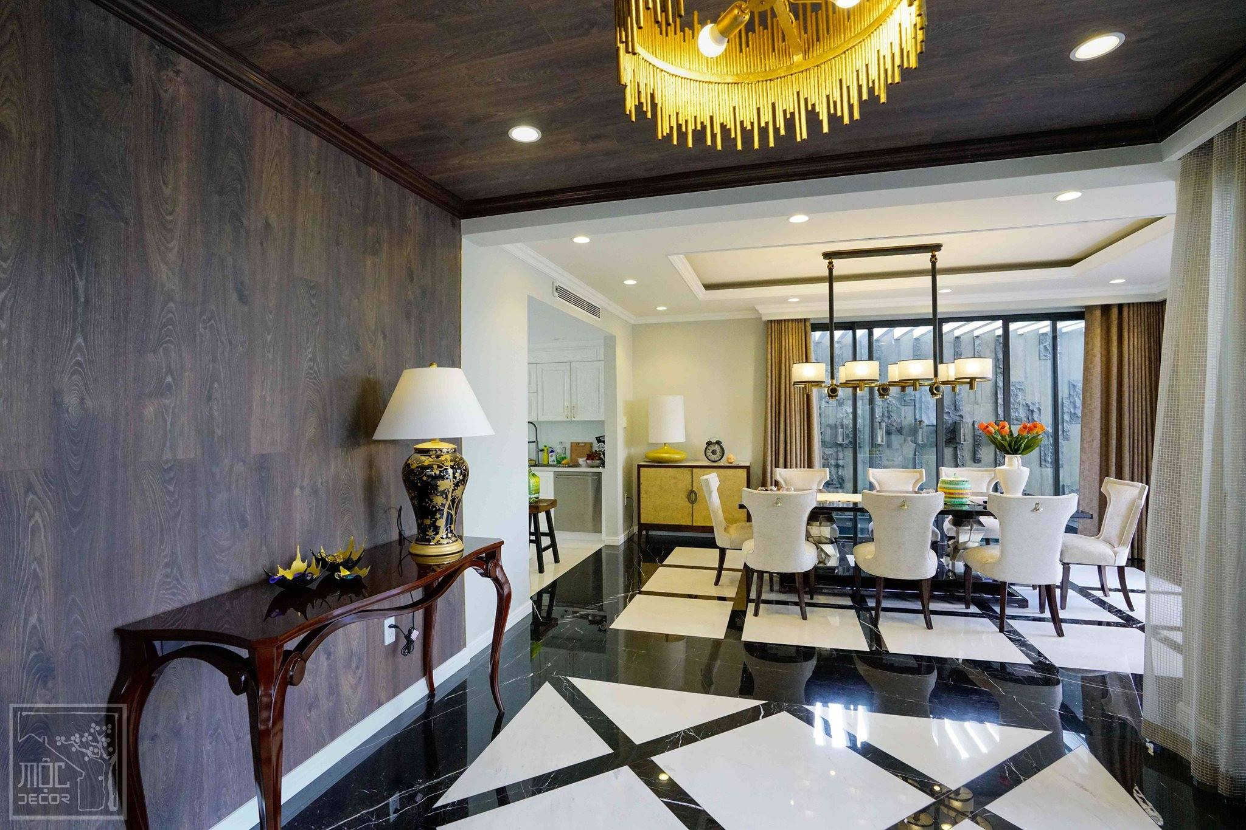
Residence Vietnam

Slide 19
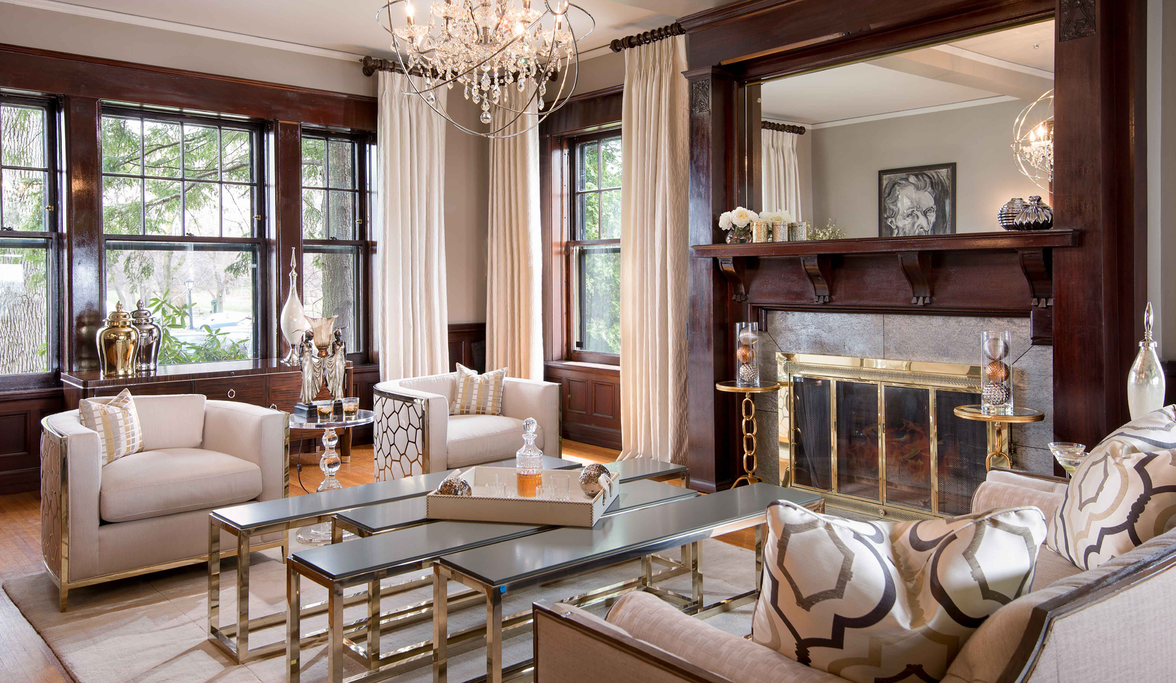
Tres Jolie Maison New York, USA

Slide 20
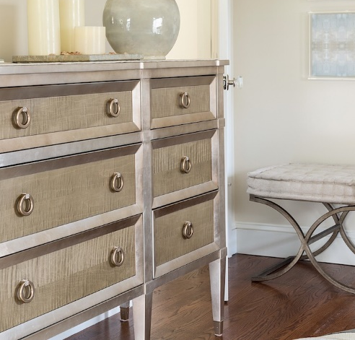
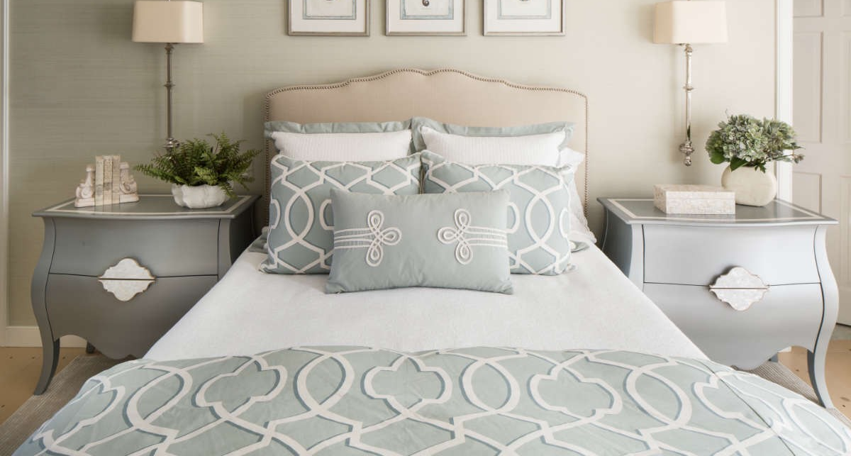
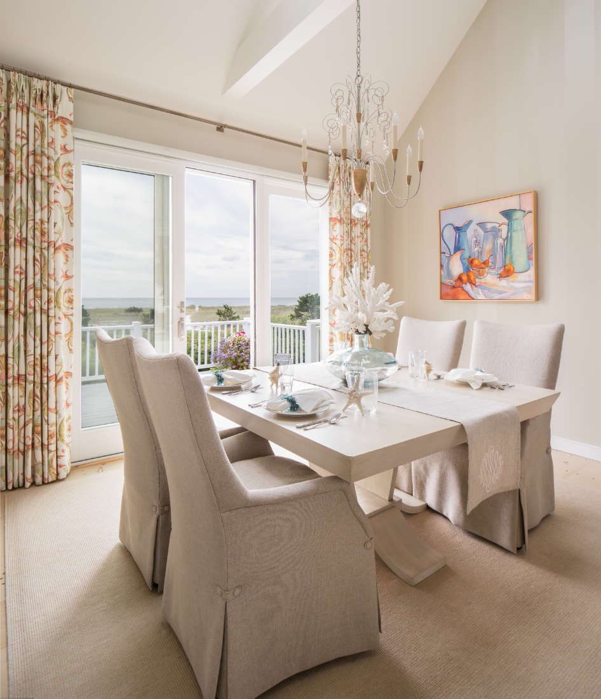
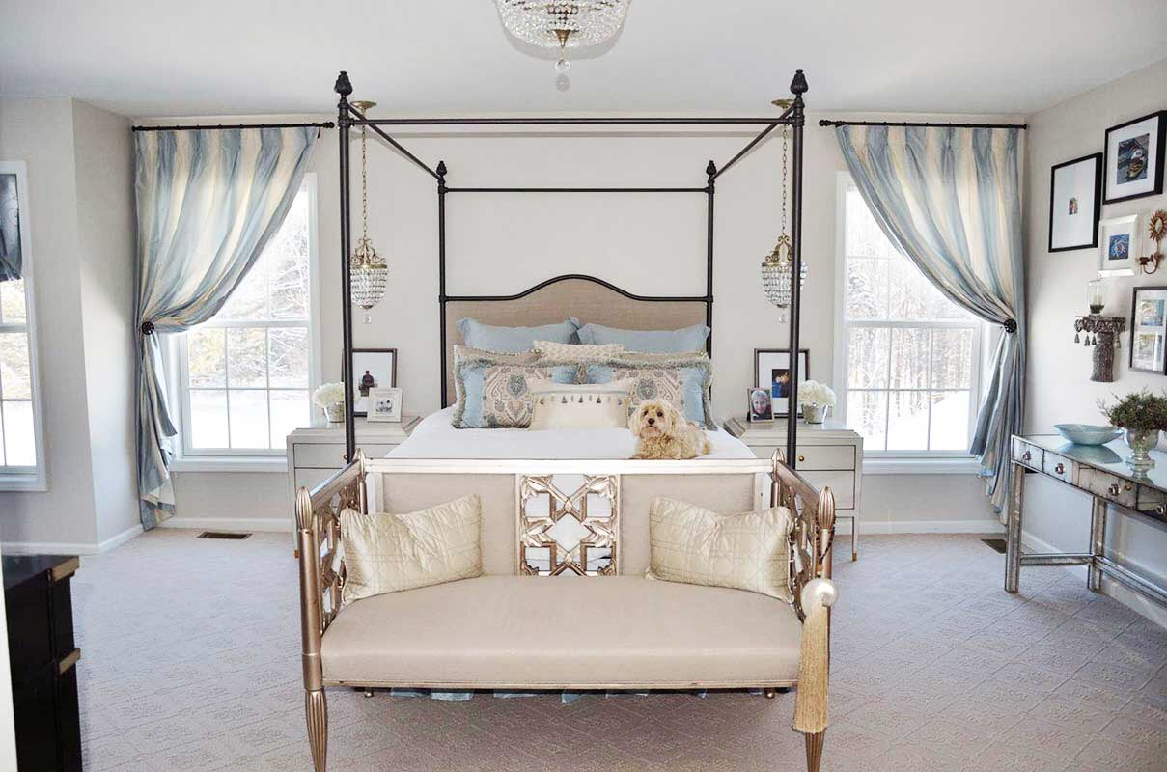
Casabella Home Furnishings
Boston, USA

Slide 21
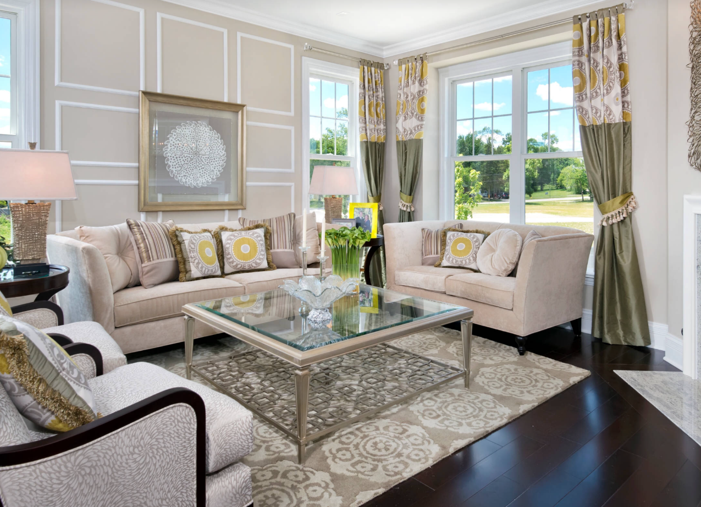
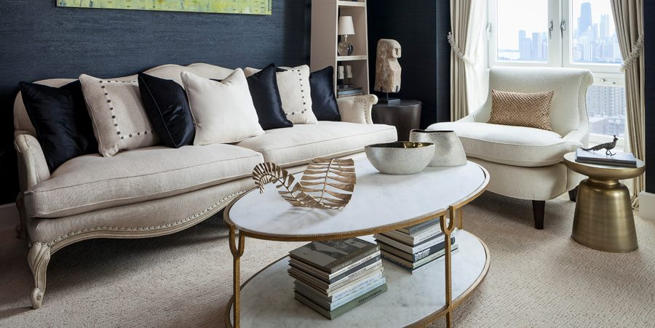
LINCOLN PARK 2550 Chicago, USA

Slide 22
Point piper apartment Sydney, Australia

Slide 23
Christopher Charles Interiors Texas, USA

Slide 24
Clive Daniel Florida, USA

Slide 25
Dallas Design Group
Dallas, USA

Slide 26
Debbie Miller
Las Vegas, USA

Slide 27
Desiderio Highvill
Astana, Kazakhstan

Slide 28
Duet Design Group
Colorado, USA

Slide 29
FIONA LAU INTERIOR DESIGN
California, USA

Slide 30
Grigoiy & Yulia Lopatka Moscow, Russia
Hamilton Park Interiors
Utah, USA

Slide 31
Gianfranco Loli Lima, Peru

Slide 32
High Gate House
Brisbane, Australia

Slide 33
Residence Beijing, China

Slide 34
Oksana Panfilova & Lyudmila Krishtaleva Kaluga Region, Russia

Slide 35
Residence
Indonesia

Slide 36
Iryna Vassyagina Ukraine

Slide 37
Jack Celi
Canada

Slide 38
VOVKarcthitects Kiev, Ukraine

Slide 39
BMAC Interiors
Los Angeles, USA

Slide 40
Lera Katassonova Kiev, Ukraine

Slide 41
Leslie Cotter Interiors
Kentucky, USA

Slide 42
Lincoln Park Chicago, USA

Slide 43
Olga Kulikovskaia Moscow, Russia

Slide 44
Lunkad Realty
India

Slide 45
Masterpiece
Design
Group
Orlando, USA

Slide 46
ML Interiors Group
Texas, USA

Slide 47
Joanne Jakab Interior Design
Ontario, Canada

Slide 48
Olga Maleva Moscow, Russia

Slide 49
REsidence Moscow, Russia

Slide 50
Design in the City
South Carolina, USA

Slide 51
Residence St. Petersburg, Russia

Slide 52
Eva Bergman Design Studio Russia

Slide 53
Sahl Design Studio
Florida, USA
Riley Interior Design
Florida, USA

Slide 54
Rafalskaya Zhanna
Russia

Slide 55
ANA Interiors
Canada

Slide 56
Robin Garceau Interiors
Connecticut, USA

Slide 57
Residence Saint-Petersburg, Russia

Slide 58
Highland Homes
Texas, USA

Slide 59
Tatyana Kuptsova Moscow, Russia

Slide 60
Viktoria Interior Design Kiev, Ukraine

Slide 61
Frahm Interiors
Canada

Slide 62
RESIDENCIAL VilLA Vietnam

Slide 63
Residence
Chicago, USA

Slide 64
Casatopia London, UK

Slide 65
Yana Molodykh Kiev, Ukraine

Slide 66
Eric Ross Interiors
Nashville, USA
Anna Paquin’s House
New Zealand

Slide 67
St. Jude’s Dream Home
Denver, USA
Lori Jolin Design
Wisconsin, USA

Slide 68
Karen Cole Designs
San Diego, USA
Karina Seimul
Moscow, Russia

Slide 69
Wilson Lighting
North Carolina, USA

Slide 70
Anne Rue Interiors
Florida, USA
Aristea Rizakos
Canada

Slide 71
Martha O’Hara Interiors
Minneapolis, USA

Slide 72
Polina Pidtsan Moscow, Russia

Slide 73
Ashley Heath Design
Philadelphia, USA
Bella Foresta
Florida, USA

Slide 74
One King’s Lane
New York, USA
Doyle Residence
New York, USA

Slide 75
Décor Design
Boston, USA

Slide 76
Elizabeth Studio Design Kiev, Ukraine

Slide 77
Insignia Design Group
Florida, USA
Jim Tschetter
North Carolina, USA

Slide 78
Bruce Willis’ Home New York, USA

Slide 79
Shirry Dolgin
Los Angeles, USA
Vladislava Gravchikova
Russia

Slide 80
Larabee’s DESIGN
Colorado, USA

Slide 81
Kari Whitman
Aspen, USA

Slide 82
Buckingham interiors + design
Chicago, USA

Slide 83
Simply Divine Interiors
Texas, USA
Ginger Yu
California, USA

Slide 84
One Kings Lane
New York, USA

Slide 85
RESIDENCE
California, USA

Slide 86
Sky Villa
Vietnam

Slide 87
Lyazzat Batyrbekova
Kazakhstan

Slide 88
Christopher Charles Interiors
Texas, USA

Slide 89
Eza Interiors
Kazakhstan

Slide 90
Maria Dadiani
Moscow, Russia

Slide 91
Residence
Vietnam

Slide 92
ResidencE
Hanoi, Vietnam

Slide 93
Restaurants & Others

Slide 94
Akaru Spa Dubai, UAE

Slide 95
Country Club North Carolina, USA

Slide 96
Country Club
North Carolina, USA

Slide 97
Elysian @stonelake
Nevada, USA

Slide 98
WORKSPACE
California, USA

Slide 99
PACIFIC RIDGE
San Diego, USA

Slide 100
Caracole Store 3F Greenbelt 5 Mall, Ayala Center, Makati City 217-6121
Caracole BGC Lot 2, Block 32, 38th Street, North Bonifacio Global City 772-2029
Dexterton Quezon City 157 Sgt. E. Rivera Street,
Quezon City 362-1111 or 361-6006
www.caracole.ph caracolephilippines
info@caracole.ph caracoleph

